Slide 1
Linked List
Prof. Sapna Sharma

Slide 2
What is data structure?
A storage that is used to store and organize data.
Arrangement of data on the computer, so that data cane accessed efficiently and easily.

Slide 3
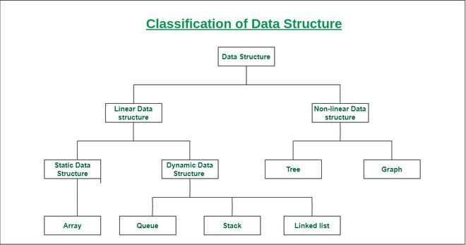

Slide 4
Need Of Data structure :
Data structure modification is easy.
It requires less time.
Save storage memory space.
Data representation is easy.
Easy access to the large database.

Slide 5
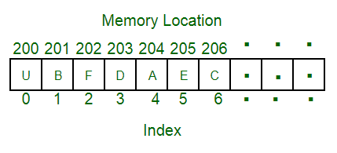
Arrays: Contigenous

Slide 6
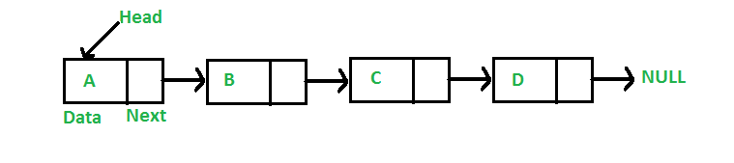
Linked list: Non Contigenous

Slide 7
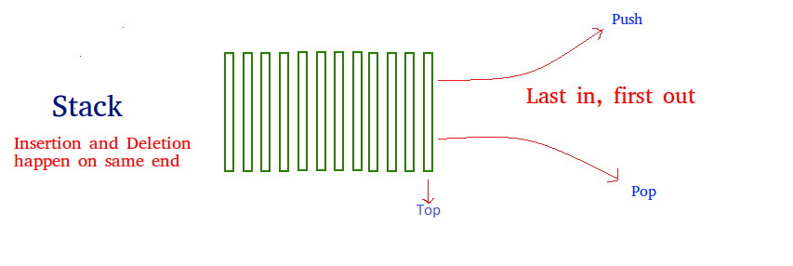
Stack: Entry and exit from one end only

Slide 8
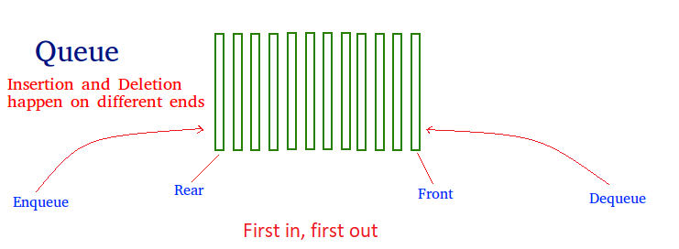
Queue:

Slide 9
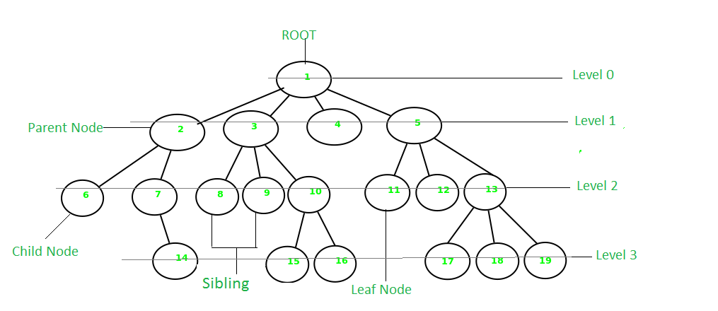
Tree:

Slide 10
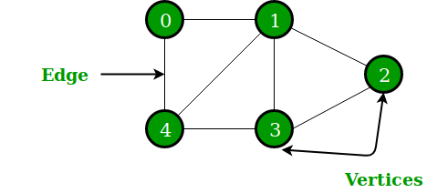
Graph:

Slide 11
What is link list?
The linked list stores data in sequential storage, like arrays.
Though the data are stored sequentially, the memory locations are not contiguous.
Unlike an array, the linked list can store data of different data types.

Slide 12


Slide 13
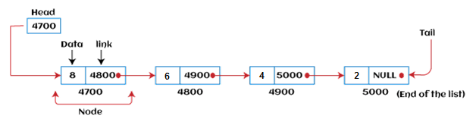

Slide 14
Add a node at the front
The new node is always added before the head of the given Linked List.
And newly added node becomes the new head of the Linked List. For example, if the given Linked List is 10->15->20->25 and we add an item 5 at the front, then the Linked List becomes 5->10->15->20->25.
Let us call the function that adds at the front of the list is push().
The push() must receive a pointer to the head pointer because the push must change the head pointer to point to the new node

Slide 15
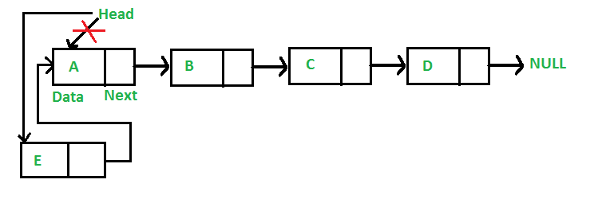

Slide 16
Why use linked list over array?
Array contains following limitations:
The size of array must be known in advance before using it in the program.
Increasing size of the array is a time taking process. It is almost impossible to expand the size of the array at run time.
All the elements in the array need to be contiguously stored in the memory. Inserting any element in the array needs shifting of all its predecessors.

Slide 17
Linked list is the data structure which can overcome all the limitations of an array. Using linked list is useful because,
It allocates the memory dynamically. All the nodes of linked list are non-contiguously stored in the memory and linked together with the help of pointers.
Sizing is no longer a problem since we do not need to define its size at the time of declaration. List grows as per the program's demand and limited to the available memory space.

Slide 18
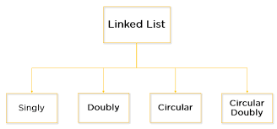
Types of Linked list

Slide 19
Singly Linked List
The node contains a pointer to the next node means that the node stores the address of the next node in the sequence.
A single linked list allows the traversal of data only in one way.

Slide 20
Operations on Single Linked List
The following operations are performed on a Single Linked List
Insertion
Deletion
Display

Slide 21
Insertion
In a single linked list, the insertion operation can be performed in three ways. They are as follows...
Inserting At Beginning of the list
Inserting At End of the list
Inserting At Specific location in the list

Slide 22
Inserting At Beginning of the list
We can use the following steps to insert a new node at beginning of the single linked list...
Step 1 - Create a newNode with given value.
Step 2 - Check whether list is Empty (head == NULL)
Step 3 - If it is Empty then, set newNode→next = NULL and head = newNode.
Step 4 - If it is Not Empty then, set newNode→next = head and head = newNode.

Slide 23
Insertion Operation
Adding a new node in linked list is a more than one step activity. We shall learn this with diagrams here.
First, create a node using the same structure and find the location where it has to be inserted.

Slide 24
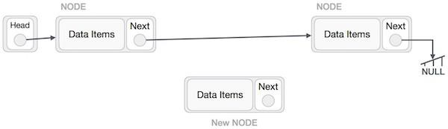

Slide 25
Imagine that we are inserting a node B (NewNode), between A (LeftNode) and C (RightNode). Then point B.next to C −
NewNode.next −> RightNode;

Slide 26
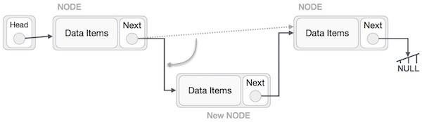

Slide 27
Now, the next node at the left should point to the new node.
LeftNode.next −> NewNode;

Slide 28
How to create node in javascript
class Node {
constructor(data) {
this.value = data;
this.next = null;
}
}

Slide 29
How to create a linked list
class Linkedlist {
constructor(data) {
//create a node
const newnode = new Node(data);
//initialize head and tail
this.head = newnode;
this.tail = newnode;
//initialize lenth
this.length = 1;
}

Slide 30
Algo for the Insertion at Beginning
1. START
2. Create a node to store the data
3. Check if the list is empty
4. If the list is empty, add the data to the node and assign the head pointer to it.
5 If the list is not empty, add the data to a node and link to the current head. Assign the head to the newly added node.
6. END

Slide 31
Insert at the start
push(value) {
const newNode = new Node(value);
// adding a node to an empty linkedlist
if (!this.length) {
this.head = newNode;
this.tail = this.head;
} else {
this.tail.next = newNode;
this.tail = newNode;
}
this.length++;
return this;
}

Slide 32
Insert from end
1. START
2. Create a new node and assign the data
3. Find the last node
4. Point the last node to new node
5. END

Slide 33
shift() {
if (!this.length) return undefined;
let temp = this.head;
if (this.length === 1) {
this.head = null; // this will beak pointer which head is pointing
this.tail = null;
} else {
this.head = this.head.next;
temp.next = null;
}
this.length--;
return temp;
}
}

Slide 34
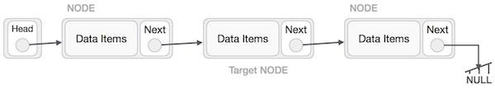
Deletion
First, locate the target node to be removed, by using searching algorithms.

Slide 35
The left (previous) node of the target node now should point to the next node of the target node −
LeftNode.next −> TargetNode.next;

Slide 36
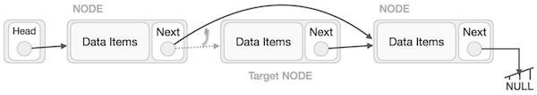

Slide 37
This will remove the link that was pointing to the target node. Now, using the following code, we will remove what the target node is pointing at.
TargetNode.next −> NULL;

Slide 38
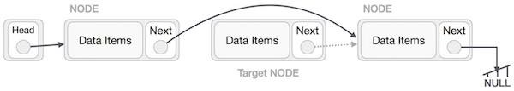

Slide 39
Deletion at Beginning
In this deletion operation of the linked, we are deleting an element from the beginning of the list. For this, we point the head to the second node.
Algorithm
1. START
2. Assign the head pointer to the next node in the list
3. END

Slide 40
shift() {
if (!this.length) return undefined;
let temp = this.head;
if (this.length === 1) {
this.head = null; // this will beak pointer which head is pointing
this.tail = null;
} else {
this.head = this.head.next;
temp.next = null;
}
this.length--;
return temp;
}
}

Slide 41
Deletion from End
Deletion at Ending
In this deletion operation of the linked, we are deleting an element from the ending of the list.
Algorithm
1. START
2. Iterate until you find the second last element in the list.
3. Assign NULL to the second last element in the list.
4. END

Slide 43
Doubly Linked List
A Doubly Linked List (DLL) contains an extra pointer, typically called the previous pointer, together with the next pointer and data which are there in the singly linked list.

Slide 44
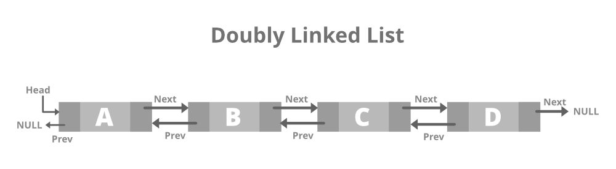

Slide 45
class Node {
// Constructor to create a new node
// next and prev is by default initialized as null
constructor(val) {
this.data = val;
this.prev = null;
this.next = null;
}
}

Slide 46
Advantages of DLL over the singly linked list:
A DLL can be traversed in both forward and backward directions.
The delete operation in DLL is more efficient if a pointer to the node to be deleted is given.
We can quickly insert a new node before a given node.
In a singly linked list, to delete a node, a pointer to the previous node is needed. To get this previous node, sometimes the list is traversed. In DLL, we can get the previous node using the previous pointer.

Slide 47
Disadvantages of DLL over the singly linked list:
Every node of DLL Requires extra space for a previous pointer. It is possible to implement DLL with a single pointer though (See this and this).
All operations require an extra pointer previous to be maintained. For example, in insertion, we need to modify previous pointers together with the next pointers. For example in the following functions for insertions at different positions, we need 1 or 2 extra steps to set the previous pointer.

Slide 48
Insertion in DLL:
A node can be added in four ways:
At the front of the DLL
After a given node.
At the end of the DLL
Before a given node.

Slide 49
1) Add a node at the front:
The new node is always added before the head of the given Linked List.
And newly added node becomes the new head of DLL.
For example, if the given Linked List is 1->0->1->5 and we add an item 5 at the front, then the Linked List becomes 5->1->0->1->5. Let us call the function that adds at the front of the list push().
The push() must receive a pointer to the head pointer because the push must change the head pointer to point to the new node

Slide 50
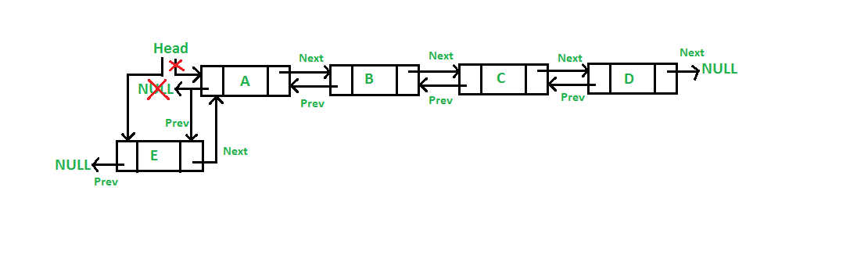

Slide 51
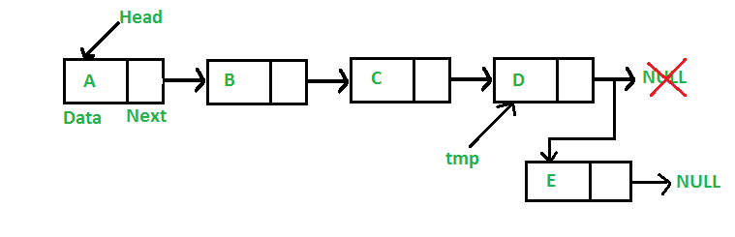

Slide 52
Application of singly linked list
Applications of linked list in the real world:
Image viewer – Previous and next images are linked and can be accessed by the next and previous buttons.
Previous and next page in a web browser – We can access the previous and next URL searched in a web browser by pressing the back and next buttons since they are linked as a linked list.
Music Player – Songs in the music player are linked to the previous and next songs. So you can play songs either from starting or ending of the list.

Slide 53
Application of Doubly Linked Lists:
Redo and undo functionality.
Use of the Back and forward button in a browser.
The most recently used section is represented by the Doubly Linked list.
Other Data structures like Stack, HashTable, and BinaryTree can also be applied by Doubly Linked List.

